Slide 1
Chapter 9: Three-Echelon Supply Chain Modeling

Slide 2




The Typical Supply Chain Has Multiple Echelons
Distribution Centers
Plant Direct Shipment
Cross Dock Facility
Temporarily Leased Space
Customers
Retailers
Demand Points
Product -Destinations
Manufacturers
Assembly Plants
Vendors
Port of Entry

Slide 3
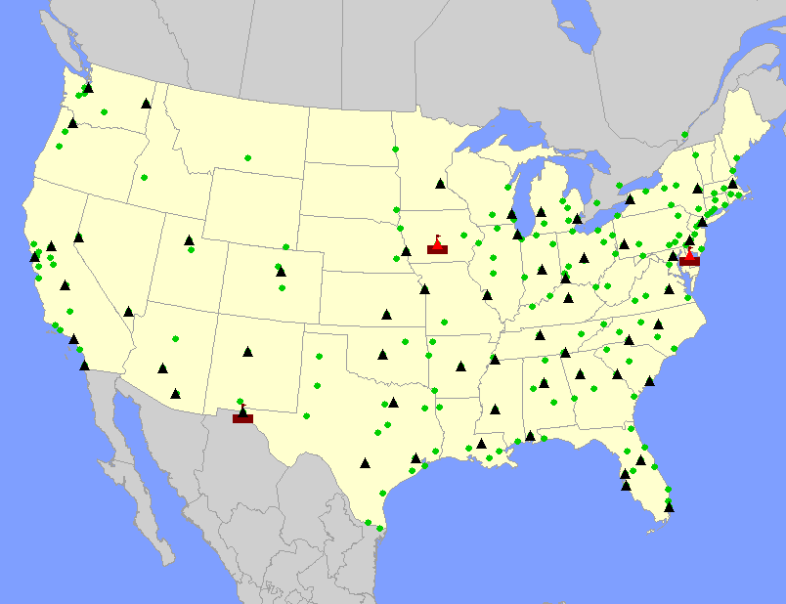
What is a Three-Echelon Supply Chain?
The Plants (the rectangles in the red boxes), must ship to the warehouses (the triangles), and the warehouses ship to customers. There is a cost for each move.
The plants are the 1st echelon, the warehouses are the 2nd echelon, and customers the 3rd. In this case, we are determining the optimal number and location of the warehouses. But, this decision must consider the cost to ship into and out of the warehouses.

Slide 4
Three-Echelon Supply Chains: Understanding the Transportation Trade-Off
#1
Truck Load
LTL
#2
Truck Load
LTL
Which Network is Lower Cost?

Slide 5
Three-Echelon Supply Chains: Understanding the Warehouse Trade-Offs
#1
Truck Load
LTL
#2
Truck Load
LTL
Which Network is Lower Cost?

Slide 6
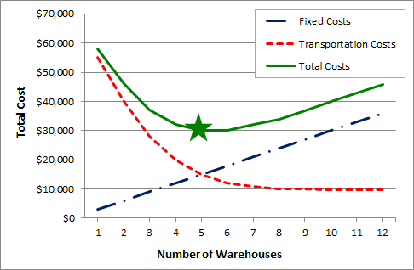
When locating warehouses, the optimization makes the trade-off between the cost of transportation and the fixed cost of warehouses

Slide 7
Note That There are Many Different Trade-Offs a Three-Echelon Model Can Make
Warehouse Fixed vs Transportation is just one
There is a trade-off between inbound and outbound transportation
If you are locating plants, you have a trade-off between the shipments of raw material into the plant vs shipments out of the plants (as well as the fixed cost of the plants)
And, remember, there is the consideration of different costs at different locations (for example, Warehouse A is less expensive than Warehouse B)

Slide 8
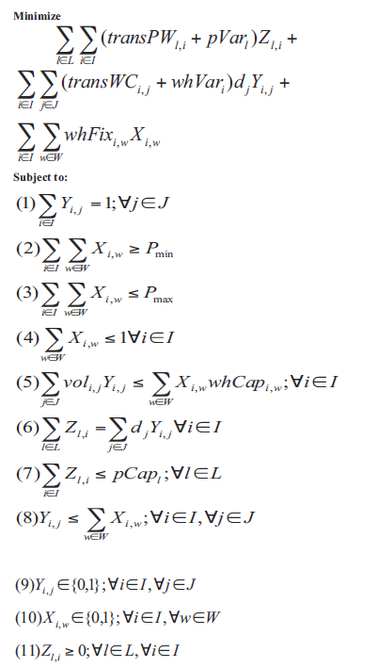
Understanding the Math Formulation
There are many ways to set this up. To keep it simple, we are modeling plants shipping to warehouses and the warehouses shipping to customers
We have unique costs for each of the different types of sites. The plant’s have their variable costs (pVar) and the warehouses have theirs (whVar)
Each site type also has unique capacity measures
The Z Decision variable is a continuous variable (it is not a 0/1 variable). It is the flow from the plants to the warehouses
Much of this you have seen before

Slide 9
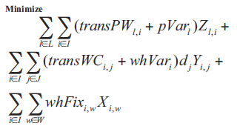
Understanding the Math Formulation: The Objective Function
1
2
3
The Objective Function breaks down to three parts
The cost to ship to the product from the plant to the warehouse and the cost to make the item at the plant
The cost to ship the product from the warehouse to the customer and the cost to process the item at the warehouse
The fixed cost of opening the warehouse
You can expand this logic to any number of echelons

Slide 10

Understanding the Math Formulation: The Conservation of Flow
This family of constraints represents the conservation of flow
These constraints are important in any model more than two echelons
They prevent product from just “materializing” at a warehouse, the product has to come from a plant
To read this constraint:
First, this constraint is for every warehouse i.
The equation says that the total amount of product shipped into warehouse i from every plant (this is the summation over the Z variables) must equal to the total product shipped out from warehouse i to every customer (this is the summation that includes the Y variables)

Slide 11
The same logic, applies to the location of plants relative to the raw materials and customers
Finished goods plants
Assembly locations
Customers
Suppliers
Raw Material Plants

Slide 12
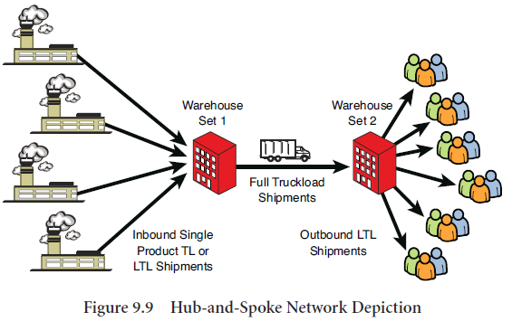
Once You Understand the Logic Of a Three-Echelon Supply Chain, You can String Together Unlimited Numbers of Echelons

Slide 13
Summary- Lessons Learned
Three-Echelon modeling makes an important extension to the model– it links supply to demand through a facility (we used a warehouse as the primary example)
Three-Echelon supply chains introduce a new trade-off, between inbound and outbound transportation
Once you understand three-echelon supply chain modeling, you can extend to any number of echelons

